Slide 1

G2M Case Study
G2M insight for Cab Investment firm
2022/9/19

Slide 2
Case Introduction & Contents
Case:
XYZ is a private firm in US. Due to remarkable growth in the Cab Industry in last few years and multiple key players in the market, it is planning for an investment in Cab industry and as per their Go-to-Market(G2M) strategy they want to understand the market before taking final decision.
Contents:
Exploratory Data Analysis
Transactions Analysis
Profit Analysis
Customers’ Preference Investigation
Cost Analysis
Seasonality
Rate of Second Glance
Conclusion

Slide 3
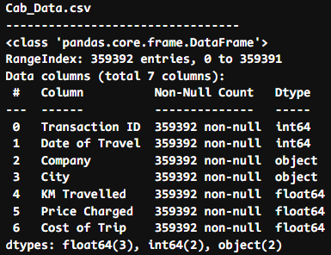
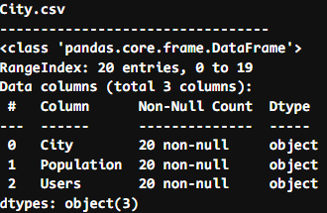

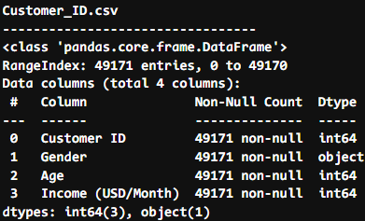
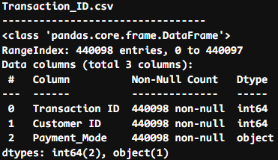
Introduce the Data Set
Final data set
By merging the four csv file together, we have the whole data set for analysis
Although due to the data set description the date is from 2016/01/31 to 2018/12/31, as we investigated the data set, we found the time period is from 2016/01/01 to 2018/12/31.

Slide 4
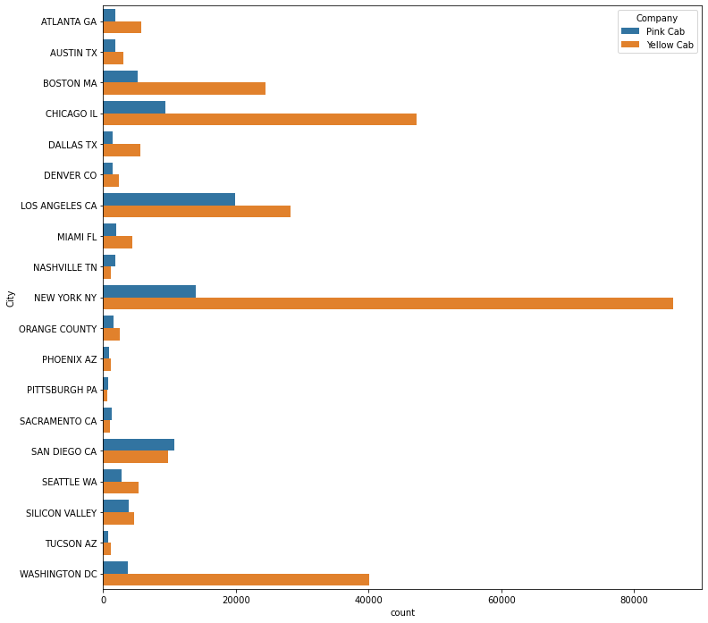
Distribution of transactions over cities
As we can see from the graph, overall, Yellow Cab makes much more transactions than Pink Cab at almost every city. We can also make an inference that Yellow Cab may make larger volume of profit than Pink Cab.
Though two cab companies have significant difference in number of transactions, their transaction follow different distributions. The top 3 cities for Yellow Cab are : New York, Chicago and Washington while for Pink Cab are : Los Angeles, New York and Chicago

Slide 5
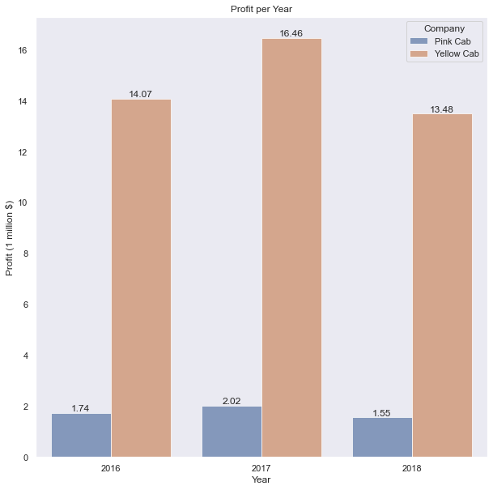
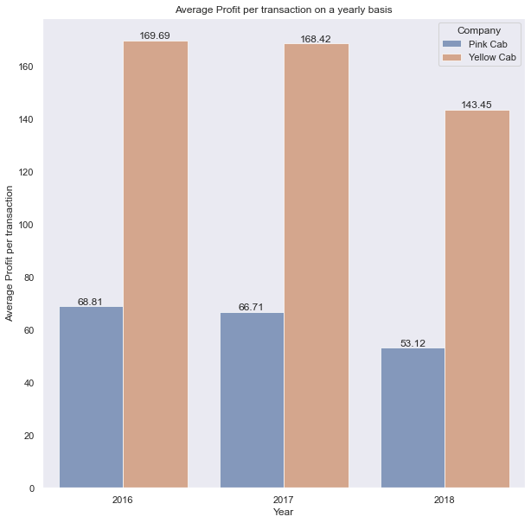
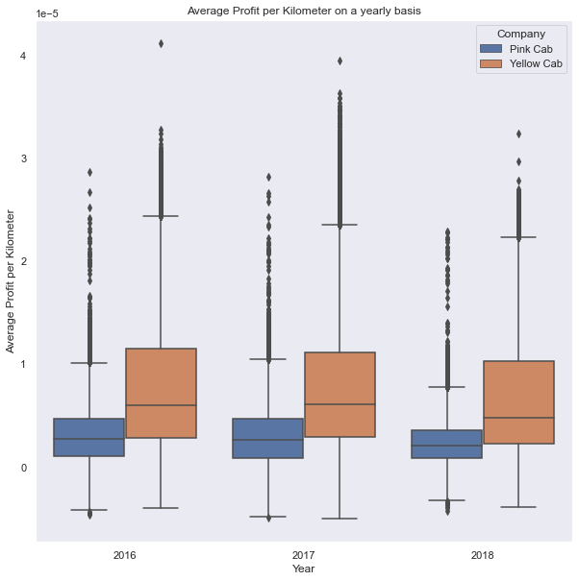
Profit Analysis
Overall, Yellow Cab makes more profit, no matter on total profit, profit per transaction or profit per kilometer.

Slide 6
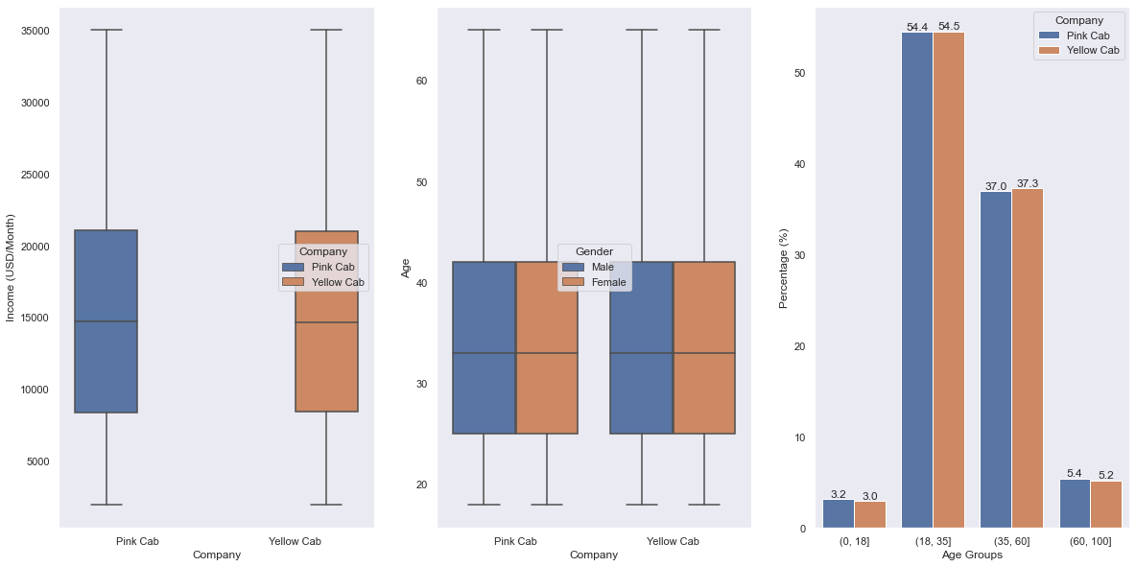
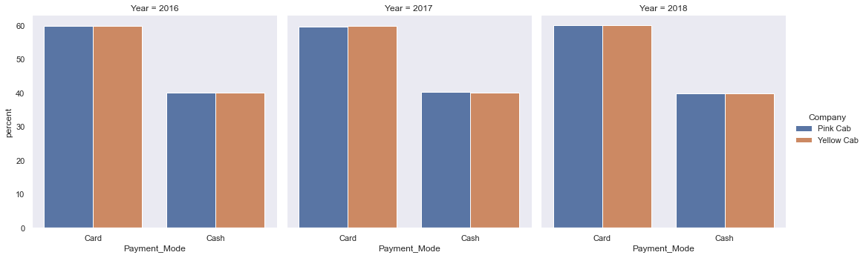
Customers’ Preference(Customer Analysis)
Although according to the distribution of transactions, there are more people choosing Yellow Cab, the user profiles for the customers of the two cab companies are similar in terms of income, gender, age group as well as payment mode.

Slide 7
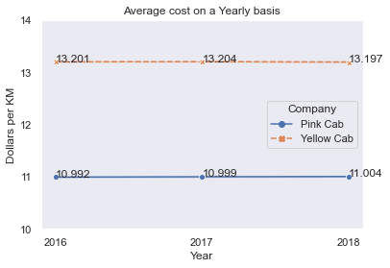
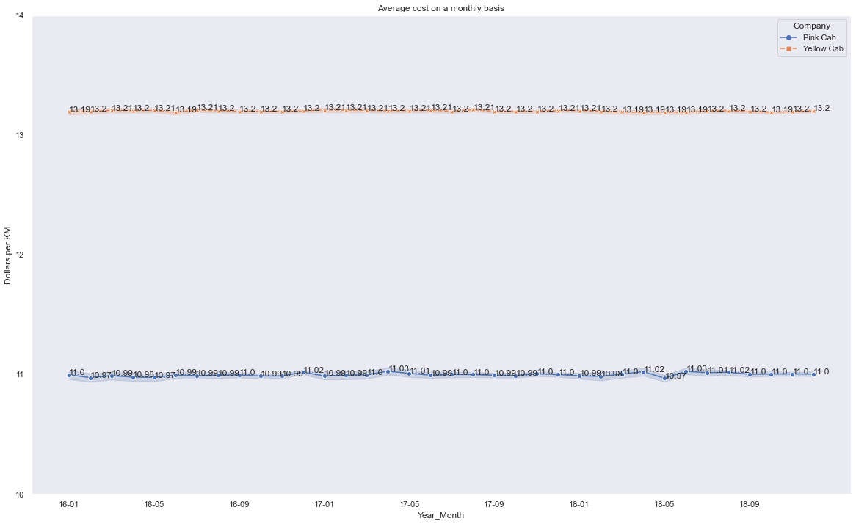
Cost Analysis
The yearly cost and monthly cost of the two cab companies both have a stable pattern, and service from Yellow Cab is 2 dollars more expensive on average.

Slide 8
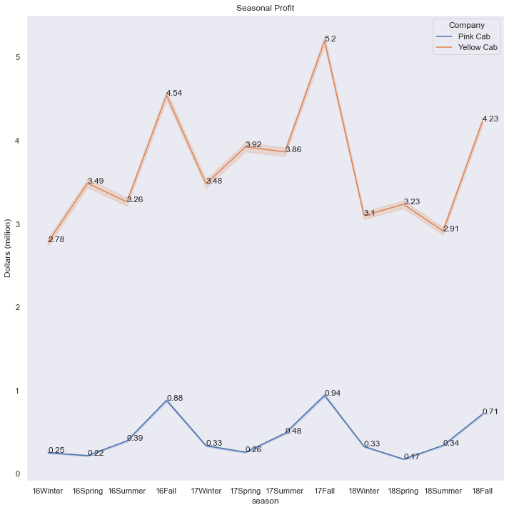
Seasonality
There does have seasonality in the patterns for profit. In each fall both cab companies make more profit than in other seasons.

Slide 9
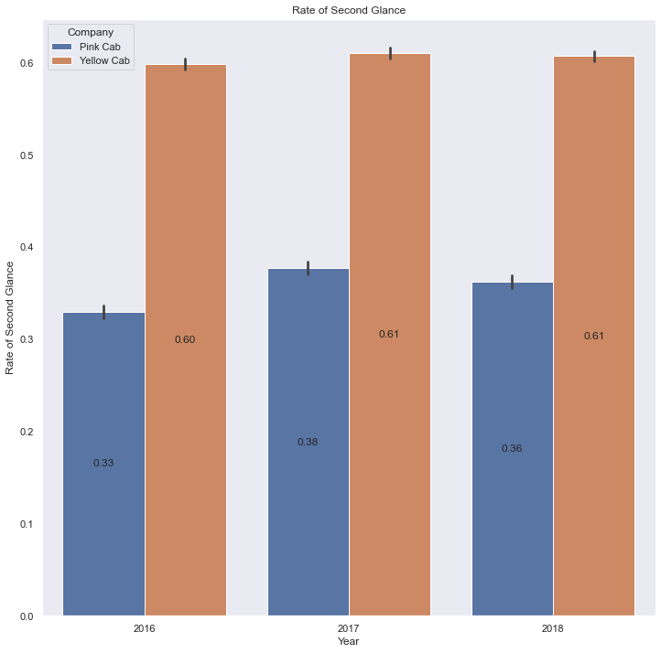
Rate of Second Glance
As we can see in the graph, Yellow Cab has a higher rate of second of glance which means that customers who receive service from Yellow Cab tend to choose Yellow Cab again when they need taxi service.

Slide 10
Conclusion
Transaction Analysis : Overall, Yellow Cab is preferred by customers.
Profit Analysis : Yellow Cab makes more profit than Pink Cab.
Customer Analysis : Gender, income and age have no influence on people's choice on cab company.
Cost Analysis : Costs for cab do not vary significantly along with time. Although Yellow Cab makes more profit, it has higher cost.
Seasonality : There is seasonality in the pattern of earnings. In fall companies can make more money.
Rate of Second Glance: Yellow cab did have a higher rate of second glance
To Summarize, choosing Yellow Cab to invest is a better.

Slide 11

Thank You

